Slide 1
Lesson 13
Reliability

Slide 2
Fault Management

Slide 3
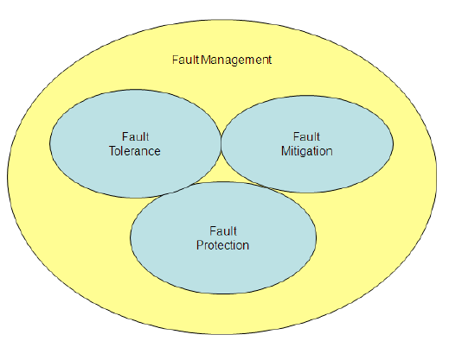
Fault Management
Fault: an abnormal condition in a system that prevents it from performing a required function, or that degrades its performance.
Fault management: an engineering discipline that addresses the occurrence of faults and provides a means for reducing their effect.
Notes:
Fault management: an engineering discipline that addresses the occurrence of faults and provides a means for reducing their effect
→ Includes fault tolerance, fault mitigation and fault protection
Fault tolerance: the number of faults that the system can tolerate and still meet its specifications
Fault mitigation: the passive mitigation of faults through design
Examples: ARM/EXECUTE command pairs for hazardous commands, extra solar array strings
Fault protection: the implementation of design intended to actively control the effects of a fault
Limited to detecting and responding to discrete defects which may arise in the operation of an otherwise healthy space vehicle
Intended to detect faults (or the effect of a fault) and intervene so that the fault does not permanently affect the safety of the space vehicle

Slide 4
Fault Management Cont.
Fault management: an engineering discipline that addresses the occurrence of faults and provides a means for reducing their effect. Includes:
Fault tolerance: the number of faults that the system can tolerate and still meet its specifications
Fault mitigation: the passive mitigation of faults through design
Fault protection: the implementation of design intended to actively control the effects of a fault
Notes:
Fault tolerance: the number of faults that the system can tolerate and still meet its specifications
Fault mitigation: the passive mitigation of faults through design
Examples: ARM/EXECUTE command pairs for hazardous commands, extra solar array strings
Fault protection: the implementation of design intended to actively control the effects of a fault
Limited to detecting and responding to discrete defects which may arise in the operation of an otherwise healthy space vehicle
Intended to detect faults (or the effect of a fault) and intervene so that the fault does not permanently affect the safety of the

Slide 5
What Fault Management Cannot Address
Four areas that fault management DOES NOT address:
(1) Defects in space vehicle engineering design
(2) Defects in the space vehicle or unit architecture
(3) Defects in the space vehicle assembly/manufacturing
(4) Defects due to common cause
Notes:
(1) Defects in space vehicle engineering design
Eg: reaction wheel bearing failure due to being incorrectly sized, software coding error
Prevention of design errors must be addressed by a thorough analysis, design review and validation program
(2) Defects in the space vehicle or unit architecture
Fault protection relies on a redundant function being available in the event that the primary has been impacted by a fault
(3) Defects in the space vehicle assembly/manufacturing
Eg: reaction wheel being installed with incorrect polarity
These errors should be addressed by a thorough ground test program
(4) Defects due to common cause
Where a process, practice or material results in a component that is deficient
Eg: part is overstressed during ground tests due to procedure and thus all parts are impacted, and redundancy is no longer helpful

Slide 6
Causes of Spacecraft Failures
Faults fall into two main categories:
Random hardware faults: assumed to occur with a constant random failure rate.
Systemic faults: including specification, design errors, improper parts and materials for the space environment, and workmanship errors.
Notes:
Faults may occur in any component of the space vehicle, or in the connections or interfaces between system components.

Slide 7
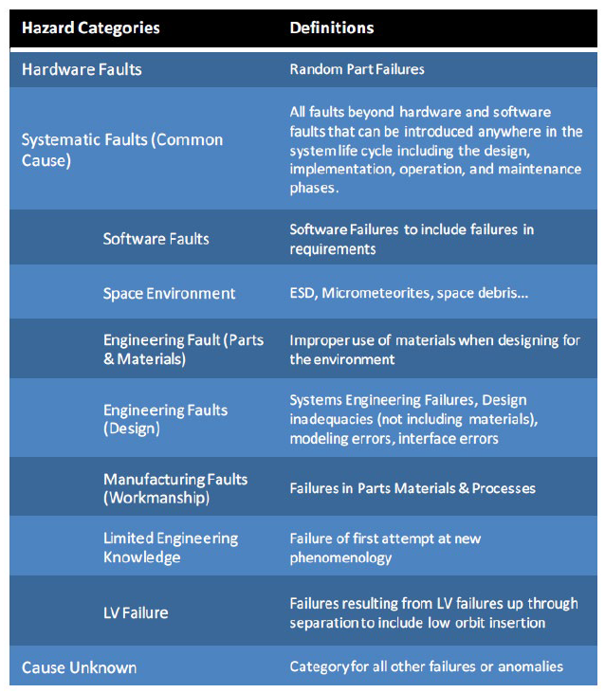
Systemic Faults

Slide 8
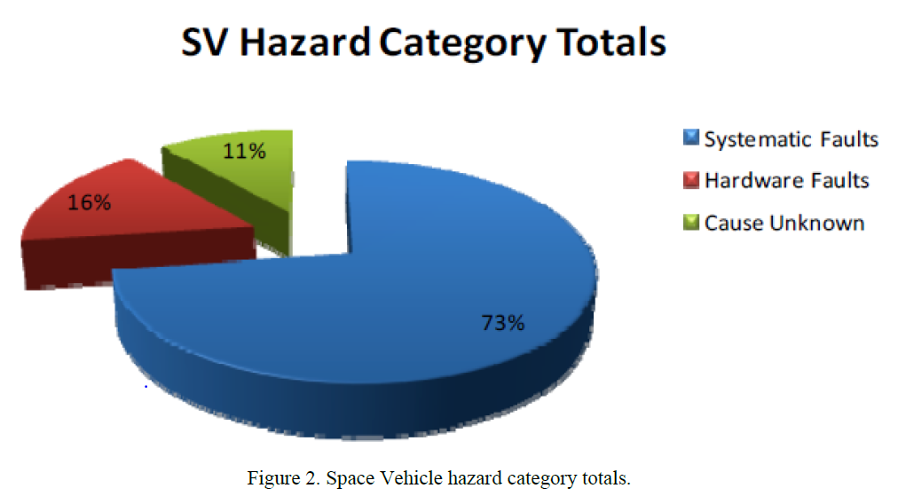

Slide 9
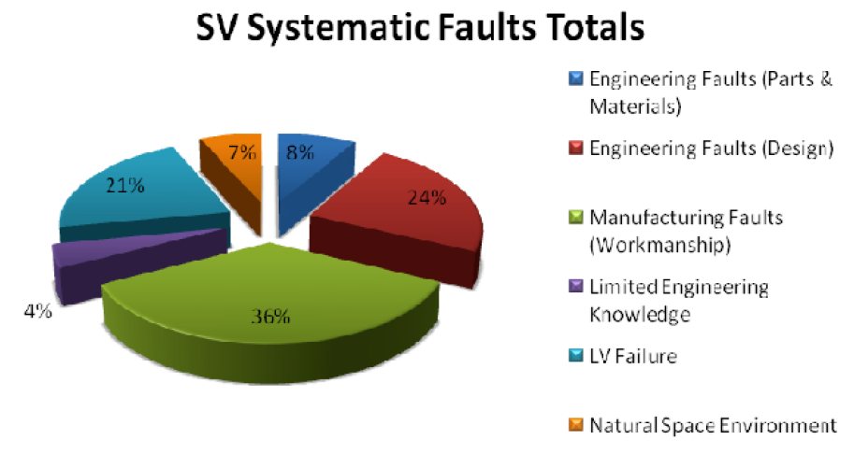
So what? Most space vehicle failures are due to systematic faults in design and manufacture rather than random hardware faults.
Notes:
To prevent systemic faults from causing mission failure, implement both robust space vehicle design/manufacture as well as a fault management system.

Slide 10
Reliability

Slide 11
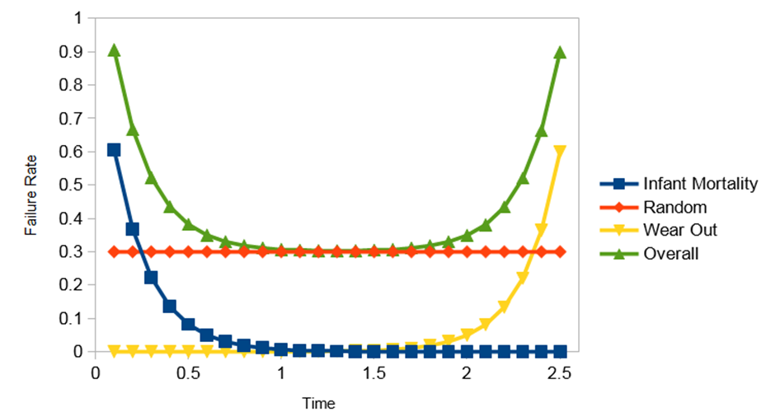
Part Failure
Failure rates are high initially due to random manufacturing defects (infant mortality)
After defective parts are weeded out: steady failure rate (failures are random, but on average at a consistent rate).
Failure rates rise again toward end of life (wear-out)
→ This is called the “bathtub” curve.

Slide 12
Reliability
The probability that a system performs its intended function without failure for a specified period of time under stated operating conditions.
Reliability requirements should stipulate:
Probability Reliability is probabilistic because failures are random.
Intended Function The system must perform its required mission function (not merely remain powered on).
Specified Time Reliability must be tied to a mission duration.
Stated Conditions Environment and operating conditions matter (radiation, thermal cycles, vibration, etc.).

Slide 13
Improving Part/Component Reliability
Process Control: Improving manufacturing processes to maintain quality, prevent defects, and ensure repeatability of spacecraft parts and assemblies.
Part Screening: Process that eliminates units that have a higher likelihood of failing in service than the other units in the lot.
Component Derating: operating a device at less than its maximum operating limit to extend the lifetime of the deice

Slide 14
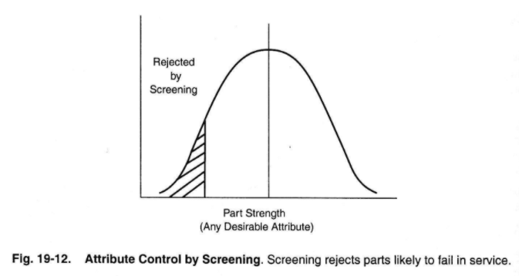
Part Screening
e.g. sensor noise, response time, max torque, etc.

Slide 15
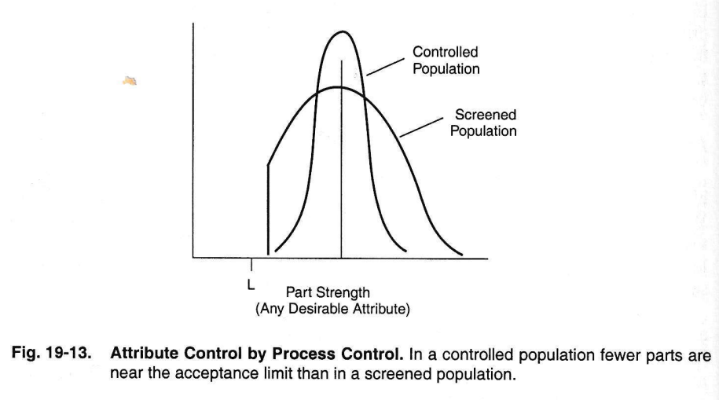
Process Control
Process control & component derating can also move mean higher
e.g. sensor noise, response time, max torque, etc.

Slide 16
Improving System Reliability
Redundancy: Having multiple methods to carry out a function, should the primary method fail. Types:
Same Design Redundancy
Diverse Design Redundancy
Functional Redundancy
K-out-of-N Redundancy
Temporal Redundancy
Notes:
Same Design Redundancy: two or more identical components with switching to allow either to be active at a time.
Diverse Design Redundancy: two or more components of a different design to accomplish the same function.
Functional Redundancy: having multiple methods of accomplishing the same function, either with multiple components or multiple combinations of components.
K-out-of-N Redundancy: pool of identical components can be assigned to replace any one of the pool of active units.
Temporal Redundancy: repetition of an unsuccessful operation (acquiring a star, firing of a pyrotechnic device, trying to communicate with the ground).

Slide 17
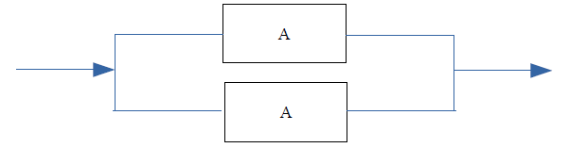
Same Design Redundancy
Example: Include two identical transmitters on the spacecraft. If the first transmitter fails, switch to the second transmitter and use it.

Slide 18
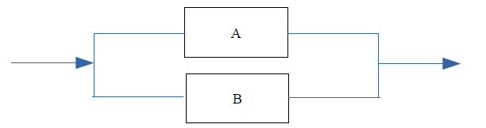
Diverse Design Redundancy
Example: Include two transmitters from separate manufacturers. If the first transmitter fails, switch to the second transmitter and use it.

Slide 19
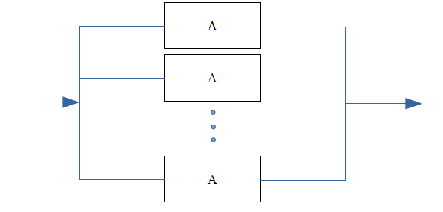
K-out-of-N Redundancy
Example: The spacecraft needs 3 solar panels to operate. Include 5 so that our mission can continue even if 2 panels fail.

Slide 20
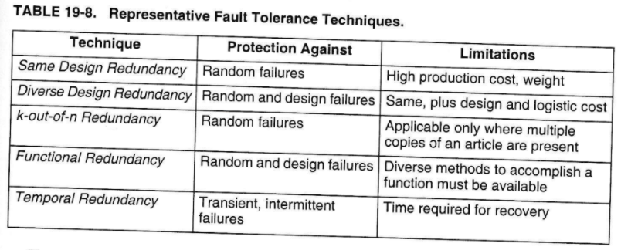
Types of Redundancy

Slide 21
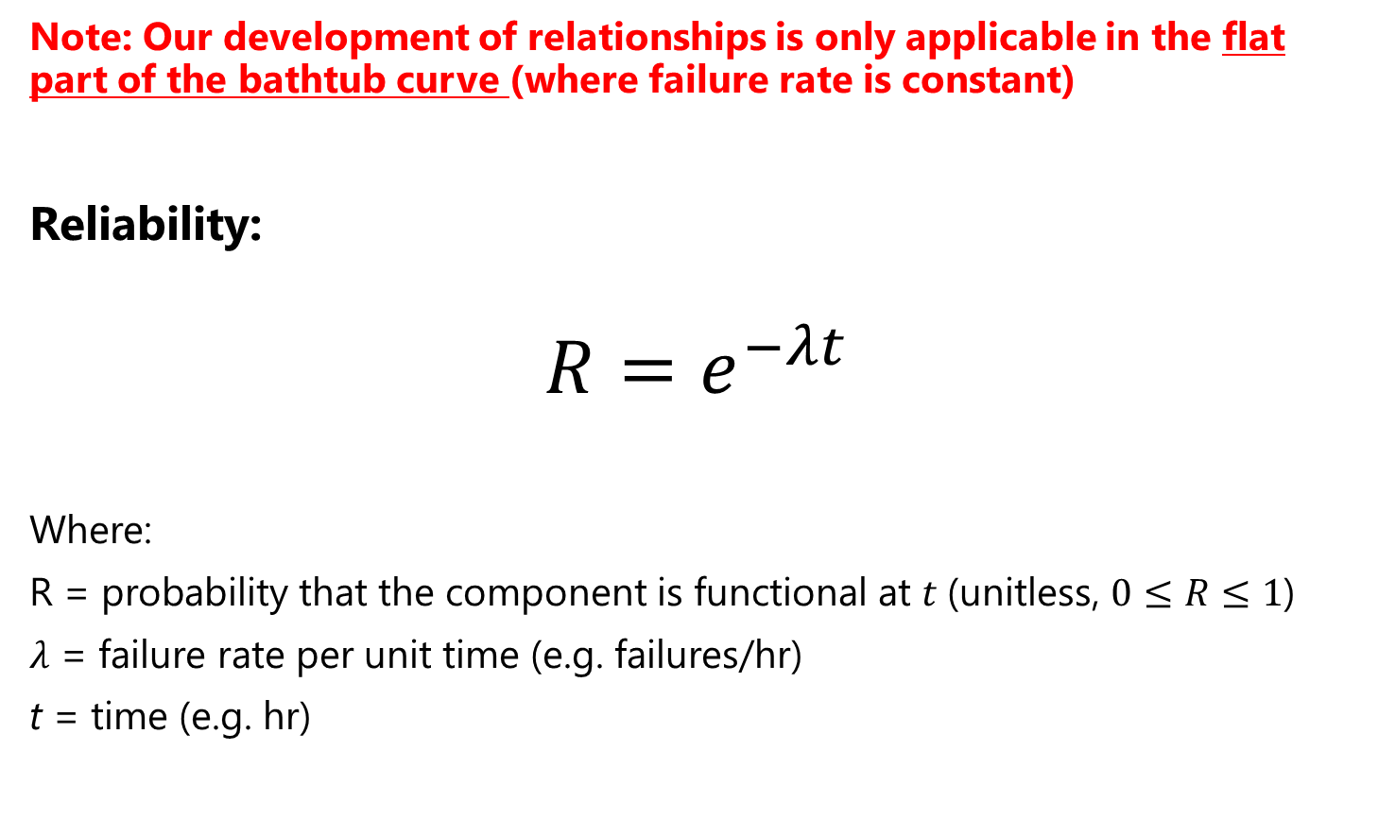
Reliability Basic Math (1/2)
Note: Our development of relationships is only applicable in the flat part of the bathtub curve (where failure rate is constant)
Reliability:
$$R=e^{−λt}$$
Where:
R = probability that the component is functional at $t$(unitless, $0≤R≤1$)
$λ$ = failure rate per unit time (e.g. failures/hr)
t = time (e.g. hr)

Slide 22
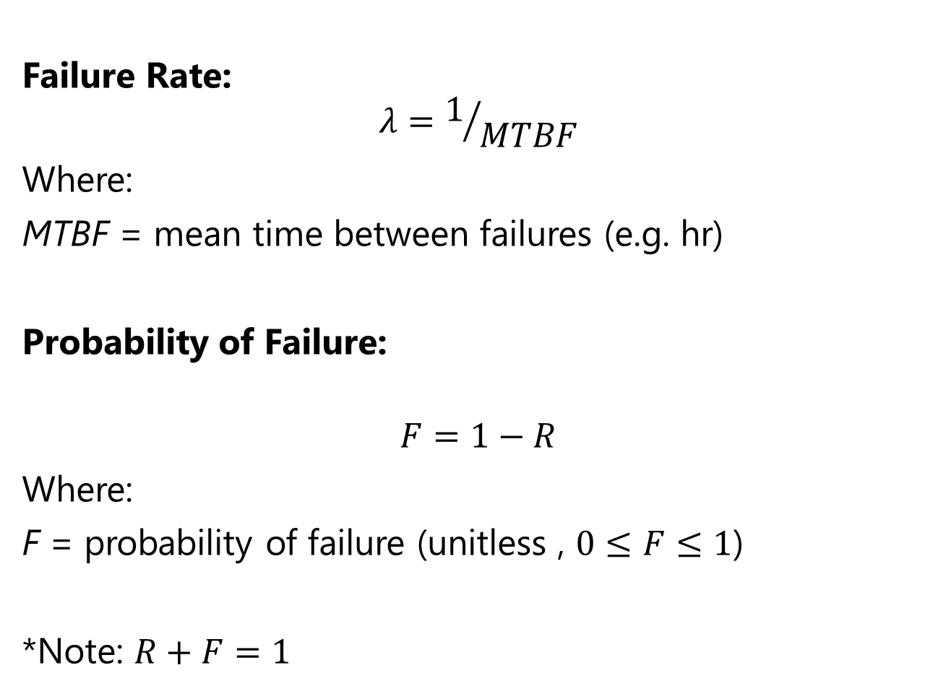
Reliability Basic Math (2/2)
Failure Rate:
$$λ=1/{MTBF}$$
Where:
MTBF = mean time between failures (e.g. hr)
Probability of Failure:
$$F=1−R$$
Where:
F = probability of failure (unitless , $0≤F≤1$)
*Note: $R+F=1$

Slide 23

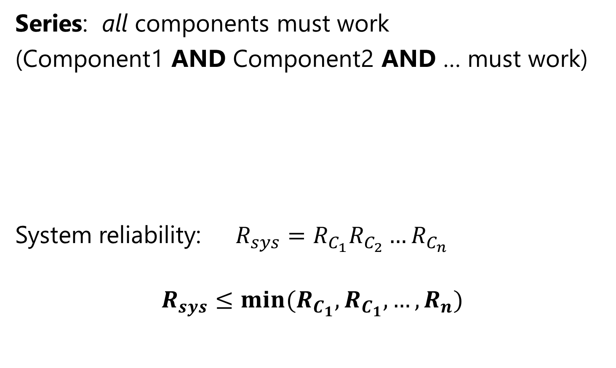
Reliability Block Diagrams (Series)
Series: all components must work
(Component1 AND Component2 AND … must work)
System reliability: $R_{sys}=R_{C_{1}}R_{C_{2}}…R_{C_{n}}$
$$R_{sys}≤min⁡(R_{C_{1}},R_{C_{1}},…,R_{n})$$

Slide 24
Effects of Reliability (Series)

Slide 25
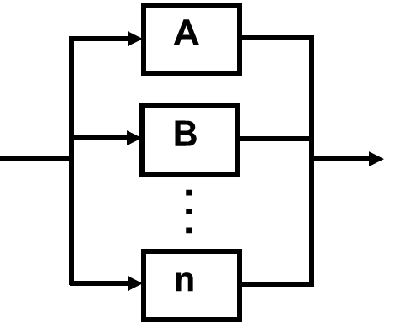

Reliability Block Diagrams (Parallel)
Parallel: Only ONE component must work
(Component1 OR Component2 OR … must work)
System reliability: $R_{sys}=1−\left[\left(1−R_{A}\right)\left(1−R_{B}\right)…\left(1−R_{n}\right)\right]$
$$R_{sys}≥\max{(R_{C_{1}},R_{C_{1}},…,R_{n})}$$

Slide 26
Effects of Reliability (Parallel)

Slide 27
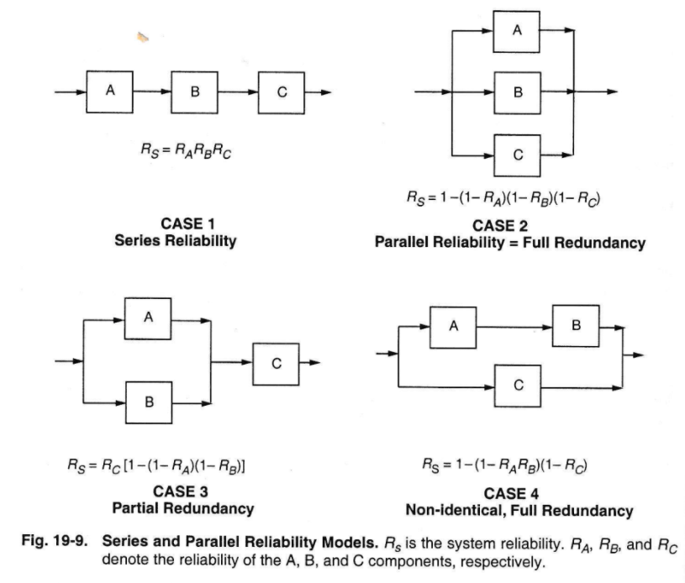
Common Redundancy Models (1/2)

Slide 28
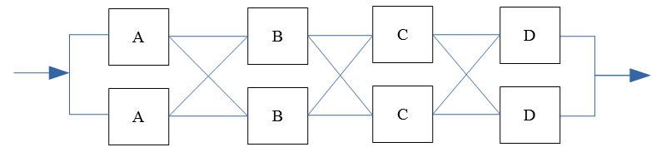
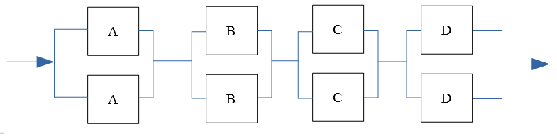
Common Redundancy Models (2/2)
Cross-Strapping (aka partitioned redundancy)
Two parallel paths where components are connected in parallel
Allows for swapping of any one component, rather than an entire “string” in case of failure
Which, through block diagram reduction, reduces to:

Slide 29
Example
Given: Block diagram & component reliabilities
Find: System reliability

Slide 30
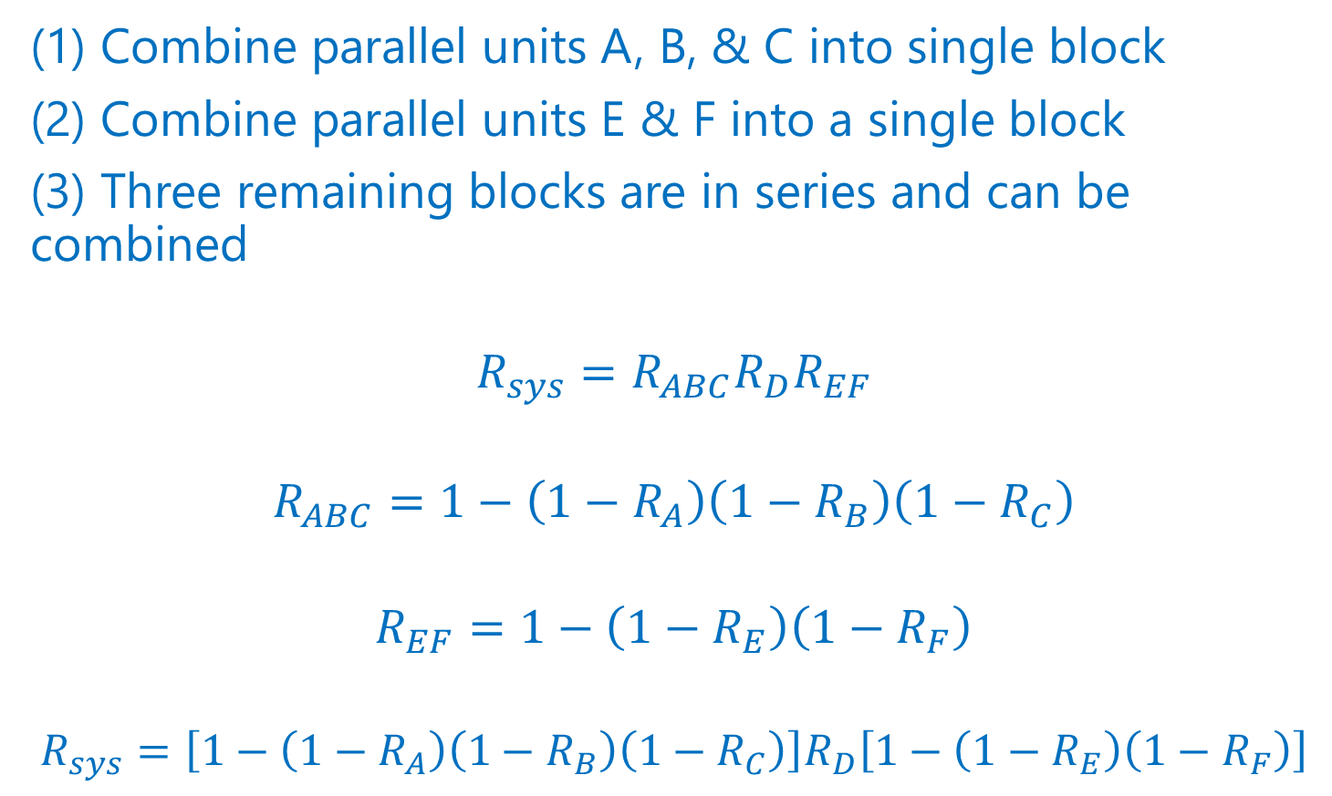
Example - Solution
(1) Combine parallel units A, B, & C into single block
(2) Combine parallel units E & F into a single block
(3) Three remaining blocks are in series and can be combined
$$R_{sys}=R_{ABC}R_{D}R_{EF}$$
$$R_{ABC}=1−\left({1−R}_{A}\right)\left({1−R}_{B}\right)\left({1−R}_{C}\right)$$
$$R_{EF}=1−\left({1−R}_{E}\right)\left({1−R}_{F}\right)$$
$$R_{sys}=\left[1−\left({1−R}_{A}\right)\left({1−R}_{B}\right)\left({1−R}_{C}\right)\right]R_{D}\left[1−\left({1−R}_{E}\right)\left({1−R}_{F}\right)\right]$$

